Slide 1

Strategy for runaway emulation
TFPIX Cornell U. team

Slide 2
Strategy for runaway emulation
Feedback loop
General set up
Thermocouple
Power supply
T_{heater}
Heater
TIM
Use Moresco PPE
Coolant
Flow
Glycol
T_{c}
Carbon Fiber/foam
Specific goal
Measure the difference between the heater temperature (T_{h}) and coolant temperature (T_{c})
as a function of the coolant temperature, i.e.
T_{h}-T_{c} vs T_{c}

Slide 3
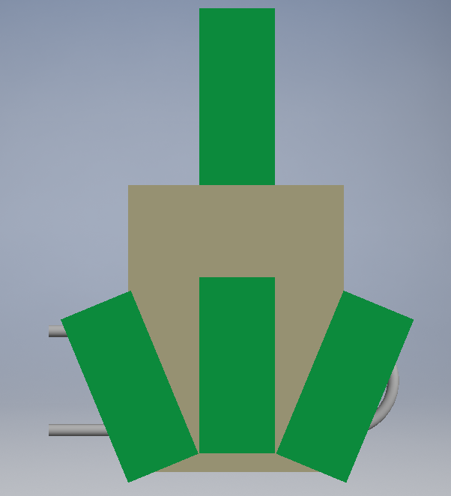

Unit cell sample (ucs)
“One module space-region”
Dimensions according to location of Neighbor modules, Cooling circuit.
Gluing according to single tube testing
Neighbor mod.

Slide 4
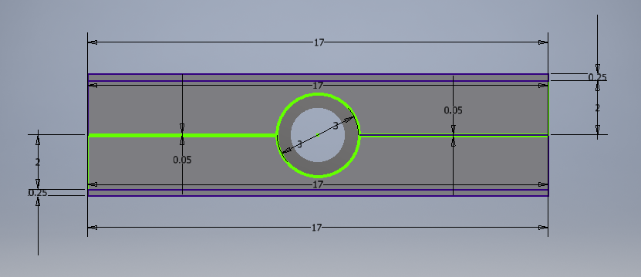
Single tube sample view
Carbon Fiber(CF)
Carbon Foam(Cf)
Half 2(h2)
Half 1(h1)
Adhesive
Tube
Adhesive: Hysol EA 9396 (Phase I BPix), CVD loaded, Graphite loaded, others.
Tubing: Stainless steel => OD=3mm, ID 2.5 mm

Slide 5
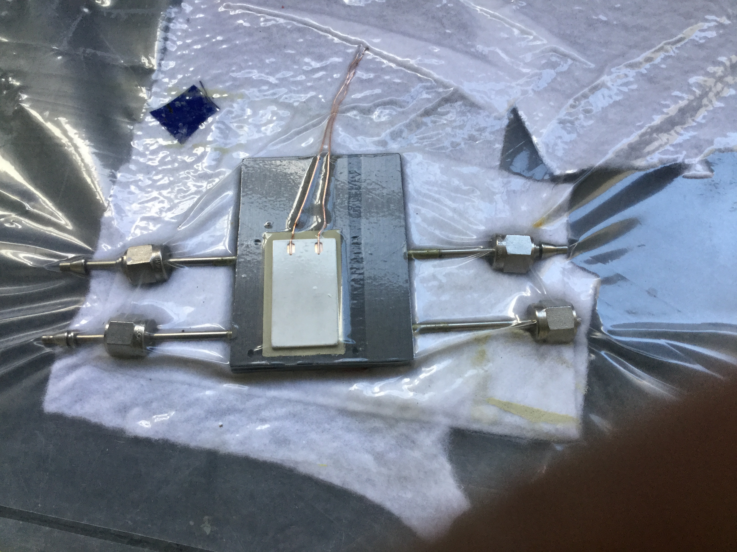
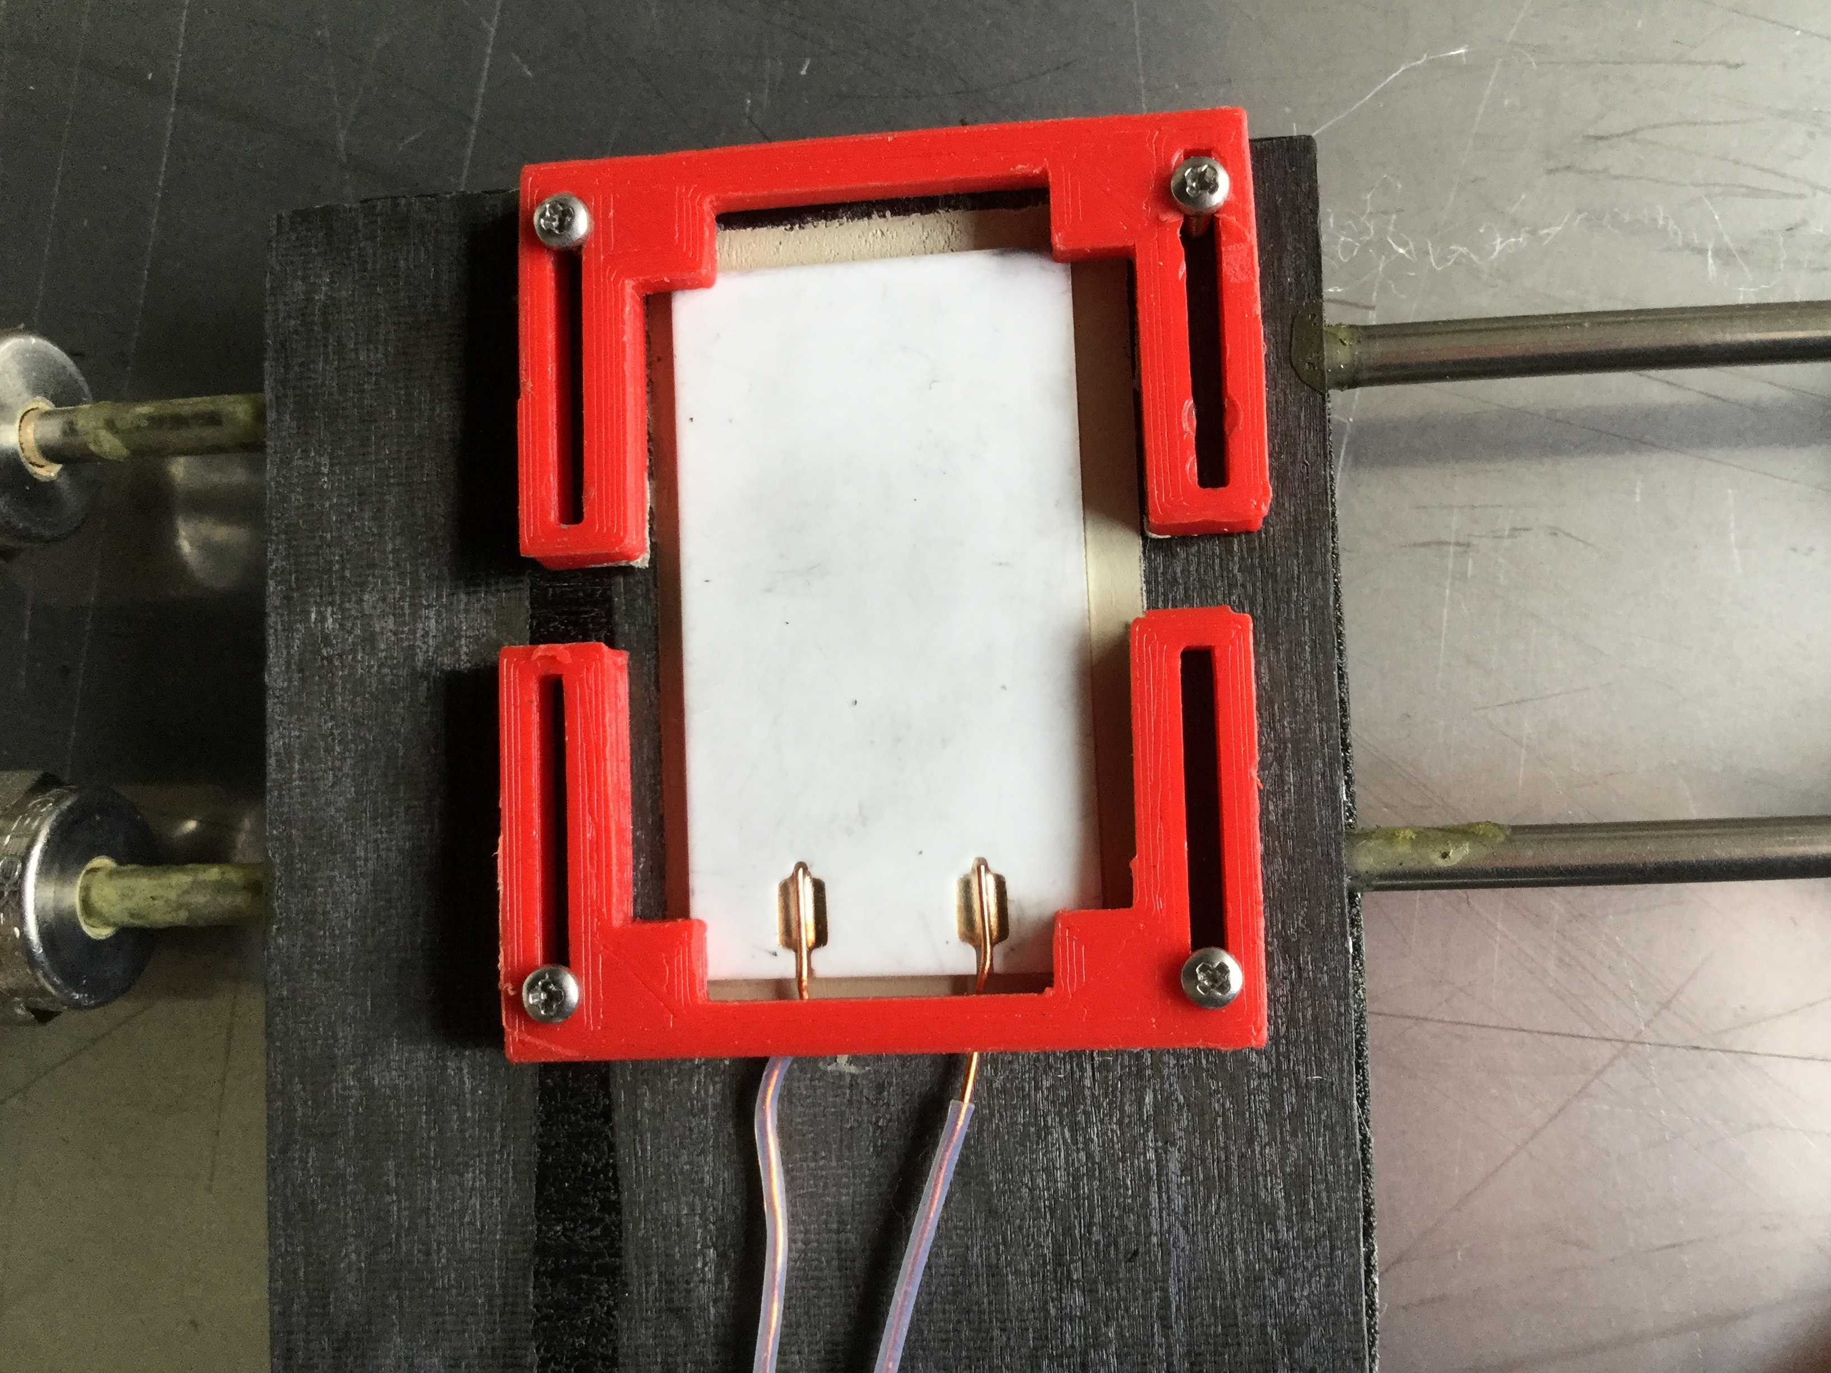
Sample preparation
Vacuum -> aiming for uniform pressure on the heater and uniformity of the TIM layer
Red clip-> hold in place the heater. Minimal pressure

Slide 6
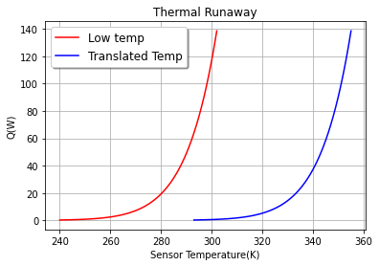
Thermal runaway(TRA) simulation
sensor volume
Fluence
Value | Parameter
2.1*10¹⁶ neq/cm² | Fluence
h=4.4 cm | length of the sensor
l=1.8 cm | width of the sensor
dd=100*10⁻⁴ cm | depletion depth
Vb=800 V | bias voltage
To=293 C | Tref
Ta=7000 C | T_{A}
for simulation
Shift by +53 C

Slide 7
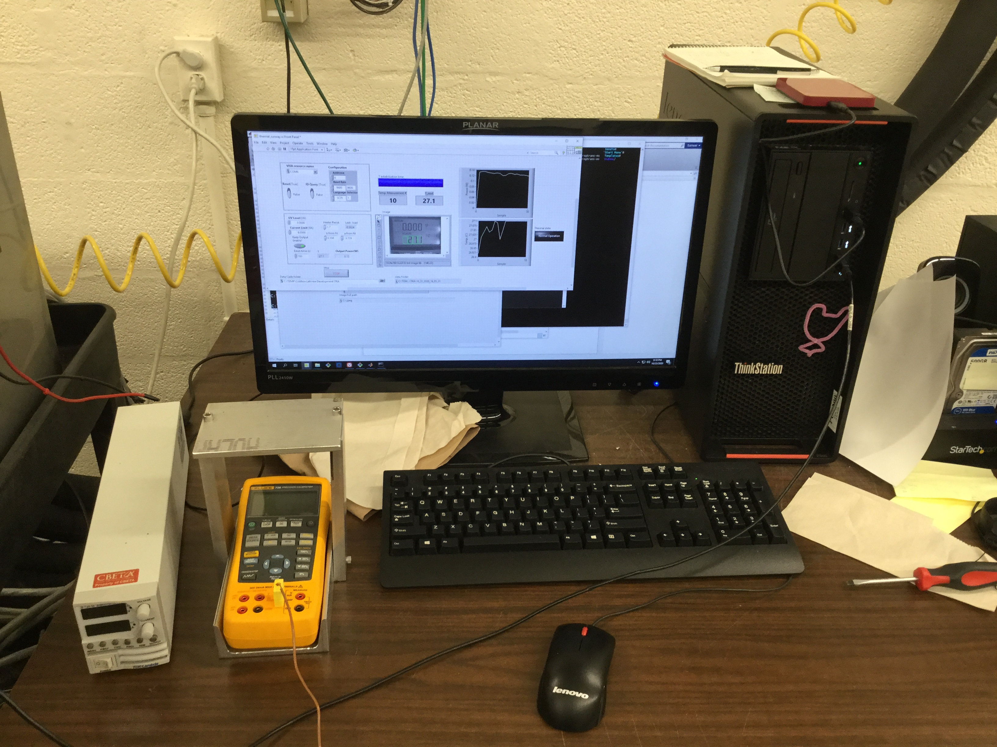
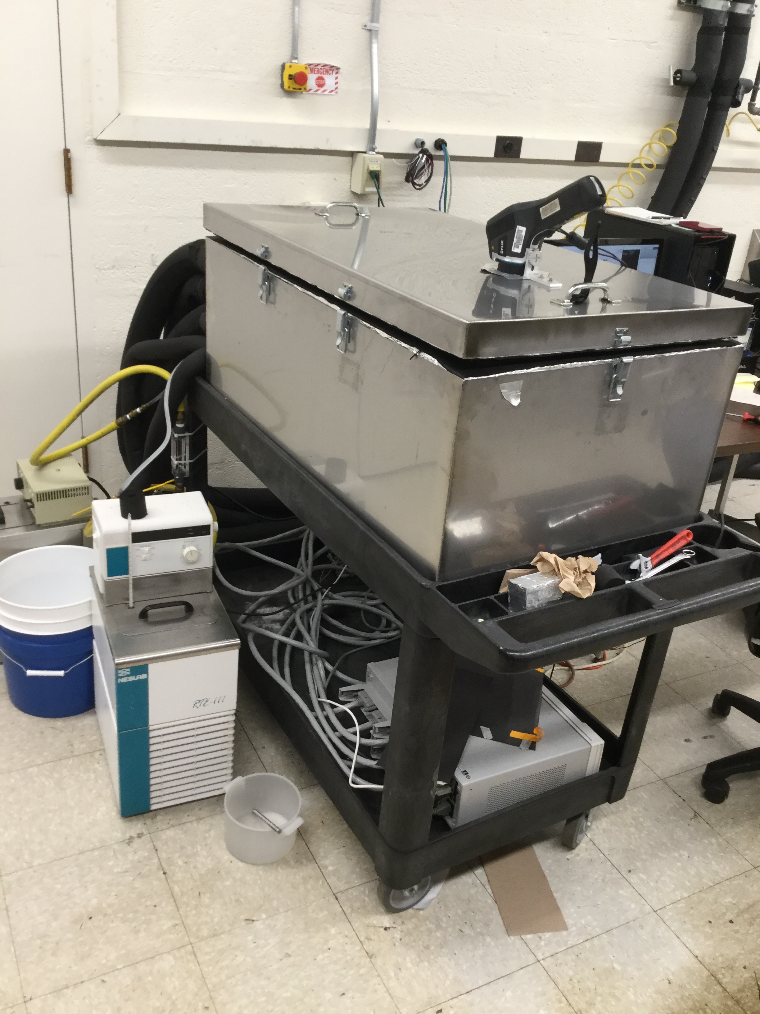
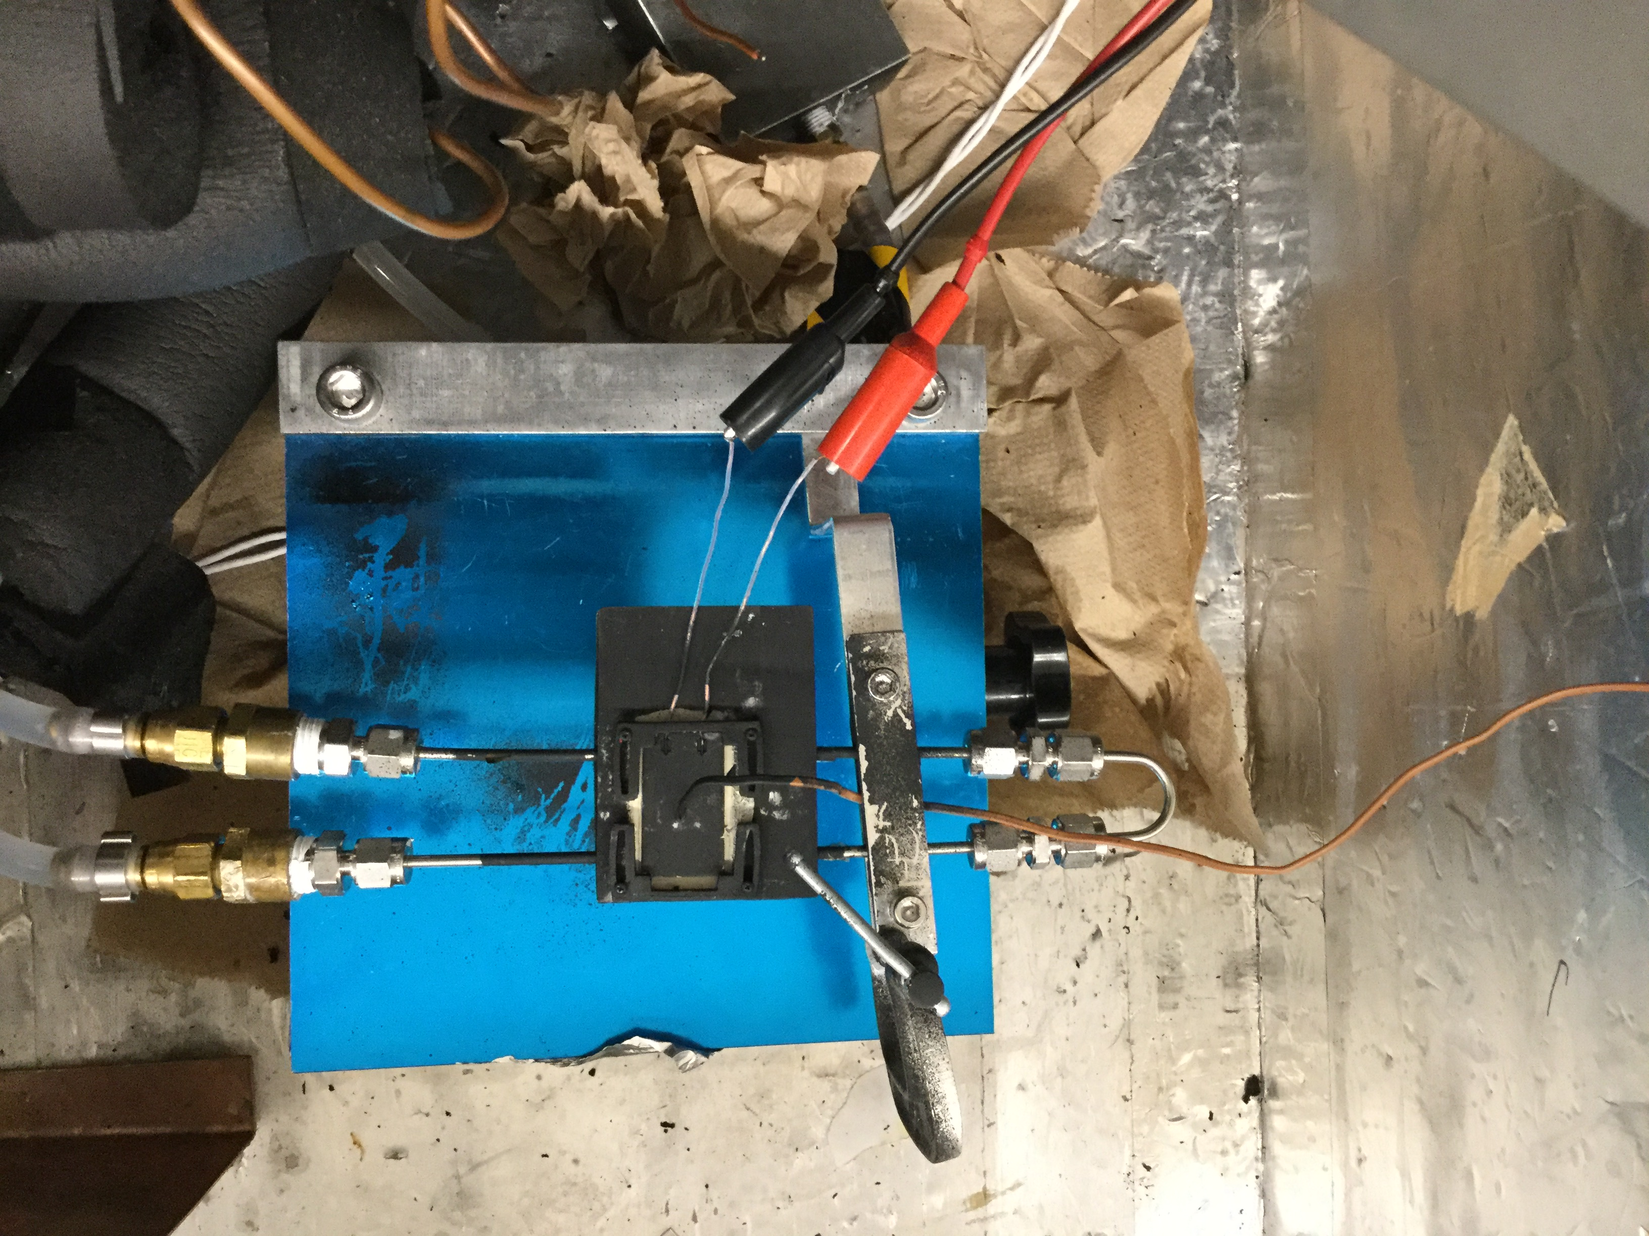
TRA data taking- setup
LabVIEW
IR camera
Power supply
Webcam
multimeter
Coldbox
To cooling
loop
Glycol Bath
Thermocouple
To power supply

Slide 8
TRA data taking-procedure
Set coolant temperature T_{c}
Set P=0 W, wait 3 min. then read T_{h} (which should be = T_{c}).
Initiate the feedback loop to control power supply:
Wait 3 minutes. Then read device temperature T_{h}.
Next iteration: Raise power level to P(T_{h}). T_{h} will increase...
Continue iterating until temperature plateaus …or thermal runaway occurs
Reminder: testing is done at 20 degC < T < 110 degC while the effects we are trying to simulate actually will take place at around -30 degC. (the 53 degC shift would be reversed ).
Fixme

Slide 9
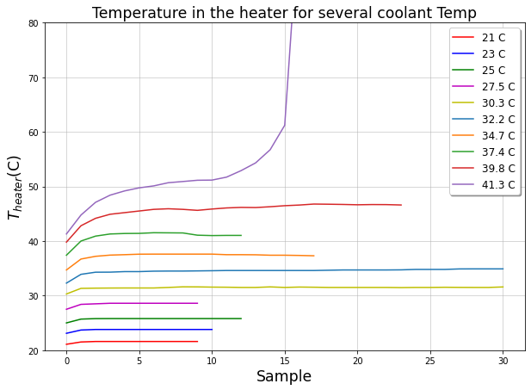
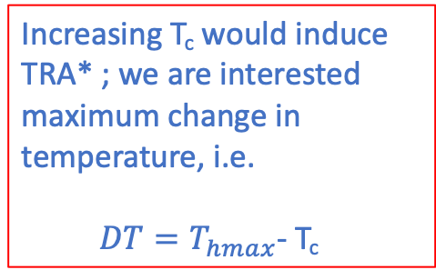
TRA data taking- Th vs Tc
TRA: T_{hmax}-T_{c} = infinity
Increasing T_{c} would induce TRA* ; we are interested maximum change in temperature, i.e.
$DT=T_{hmax}$- T_{c}
If no TRA then T_{hmax}= T_{plateau}
* Increase in fluence and/or TIM performance will also induce TRA but we concentrate in one effect at a time.

Slide 10
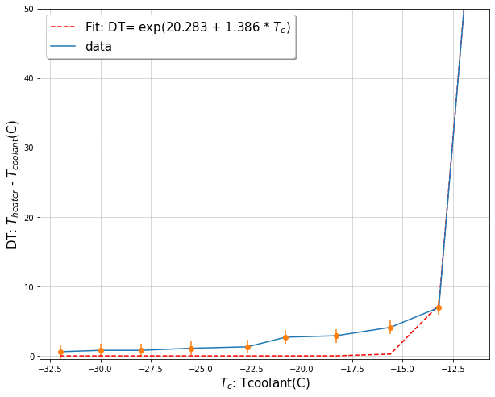
TRA: DT vs Tc
Note the Tc scale was shifted back to low temperature range.
Error bars corresponds to an estimate of 1 degC

Slide 11
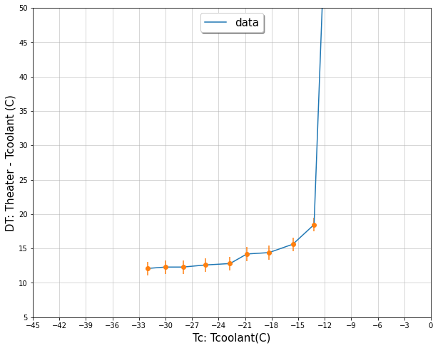
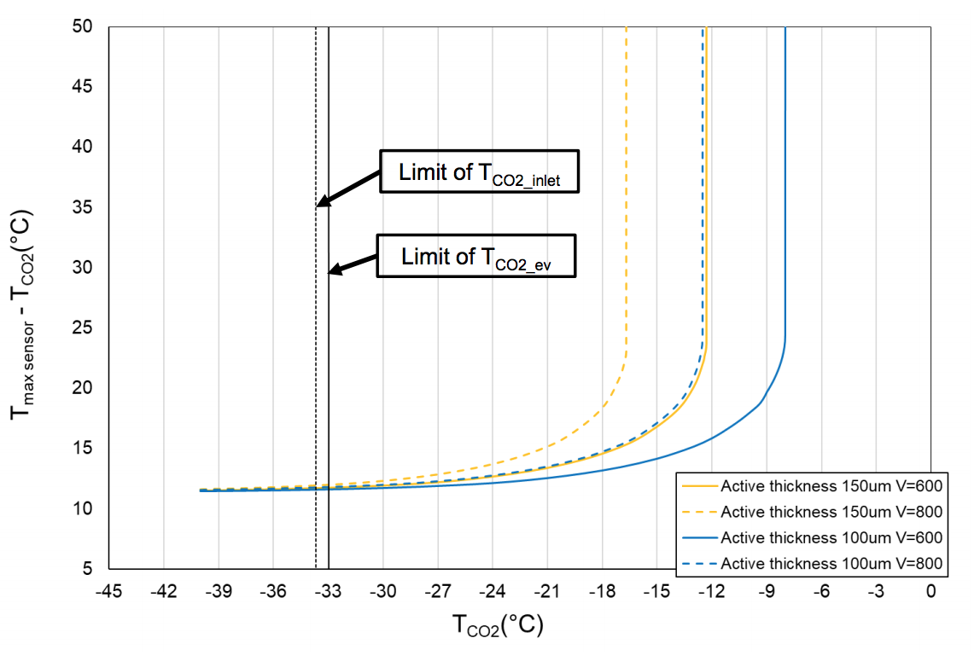
TRA Lab simulation vs Ansys
Ansys
We are interested in the Ansys thermal simulation of our sample

Slide 12
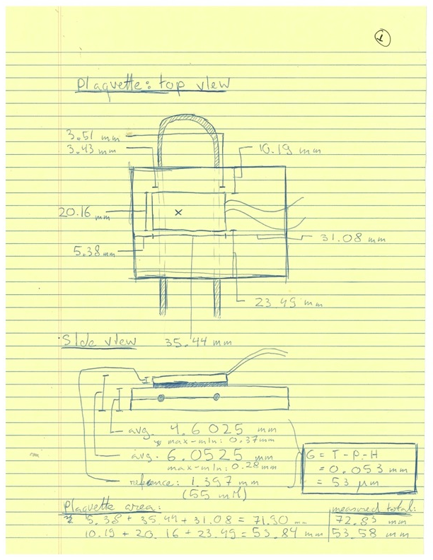
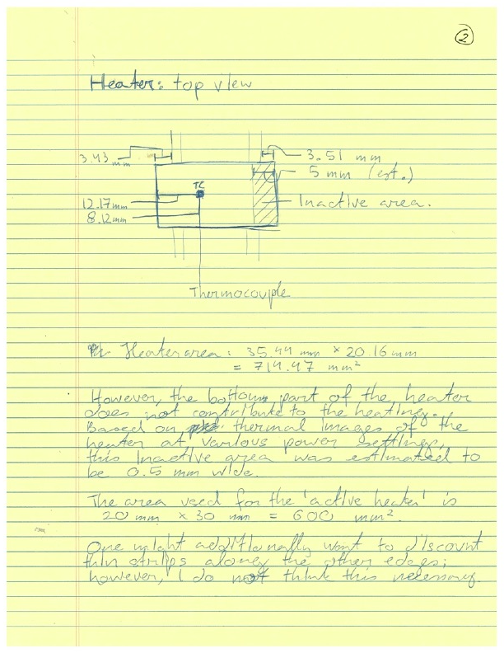
Sample features and schematic I

Slide 13
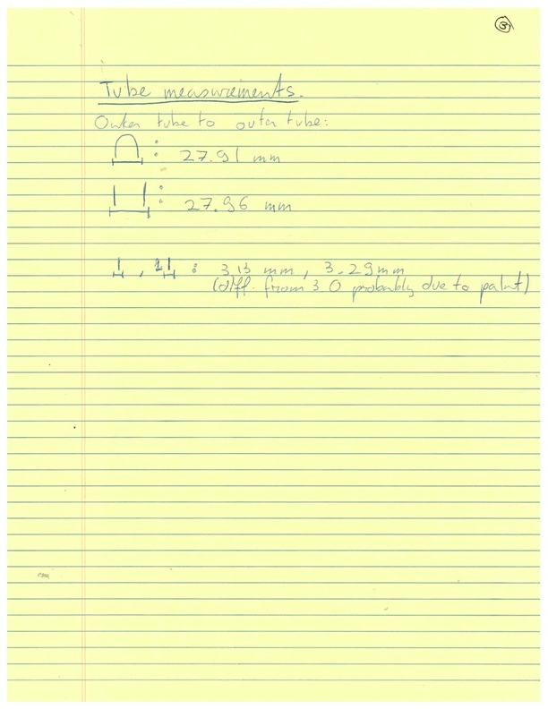
Sample features and schematic II

